Slide 1
Java Collections
Jakub Kaczyński, Maciej Kucharek, Michał Dubel

Slide 2
Few words before we start
This workshop session is heavily based on Java Generics and Collections by Maurice Naftalin & Philip Wadler
We strongly recommend you to read the book
It gives a solid understanding on how Generics work (must-have for any Java developer)
It describes the Collection framework in details
Please hold your questions till the end of the presentation

Slide 3
Agenda
Introduction
Preliminaries to Java Collections Framework
Collections and thread safety
Framework overview:
Collection interface
Sets
Queues
Lists
Maps
Collections utility class
Summary
Notes:
Wypisalem tu wszystko co przyszlo mi na mysl, na pewno trzeba ten slajd poprawic

Slide 4
Introduction to Java Collections

Slide 5
Introduction to Java Collections
Java Collections Framework:
Interfaces and concrete classes, that represents data structures.
It’s not a framework, it’s a library ;-)
Fundamentals from Java 1.2.
Packages: java.util i java.util.concurrent

Slide 6
Collection / collection / Collections
Collection – concrete class: java.util.Collection, top of interface hierarchy,
collection – concrete data structure,
Collections – concrete class: java.util.Collections – util class, a few static methods.

Slide 7
Main Interfaces in Java Collections Framework

Slide 8
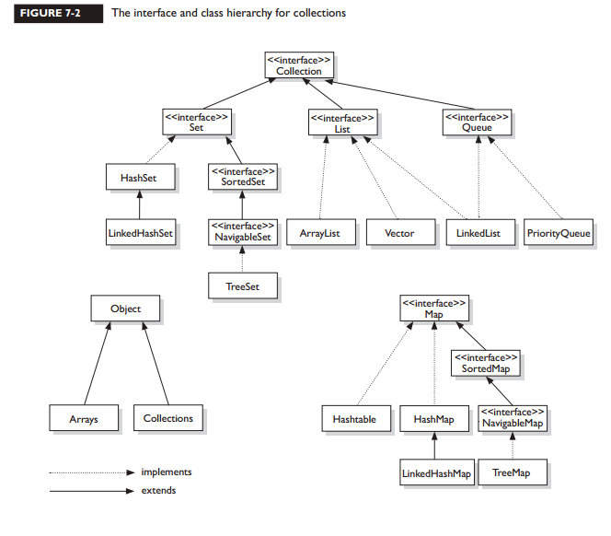
Main Interfaces in Java Collections Framework

Slide 9
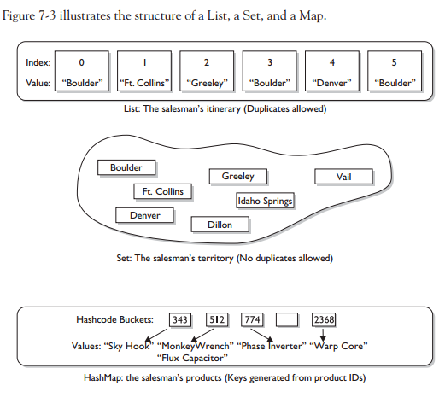
Main Interfaces in Java Collections Framework

Slide 10
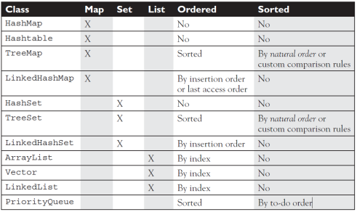
Ordered vs Sorted

Slide 11
Preliminaries

Slide 12
Equals
public boolean equals(Object anObject) {
if (this == anObject) {
return true;
}
if (anObject instanceof String) {
String anotherString = (String)anObject;
int n = value.length;
if (n == anotherString.value.length) {
char v1[] = value;
char v2[] = anotherString.value;
int i = 0;
while (n-- != 0) {
if (v1[i] != v2[i])
return false;
i++;
}
return true;
}
}
return false;
}

Slide 13
HashCode
public int hashCode() {
int h = hash;
if (h == 0 && value.length > 0) {
char val[] = value;
for (int i = 0; i < value.length; i++) {
h = 31 * h + val[i];
}
hash = h;
}
return h;
}

Slide 14
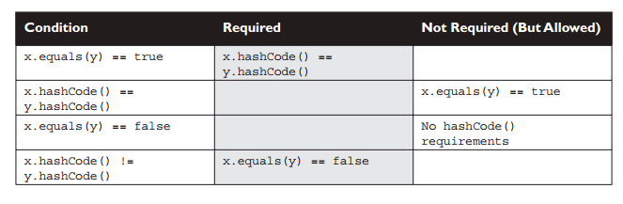
HashCode contract

Slide 15
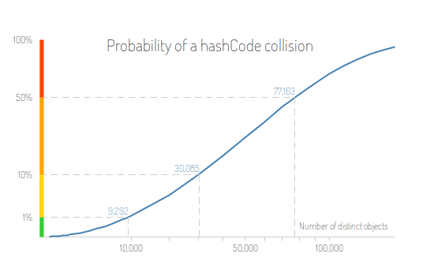
HashCode efficiency

Slide 16
Iterable and Iterator
public interface Iterator<E> {
boolean hasNext();
E next();
void remove();
}
public Iterable<T> {
Iterator<T> iterator();
}

Slide 17
Comparable and Comparator
public interface Comparable<T> {
public int compareTo(T o);
}
compareTo returns:
Negative: thisObject < anotherObject
Zero: thisObject == anotherObject
Positive: thisObject > anotherObject

Slide 18
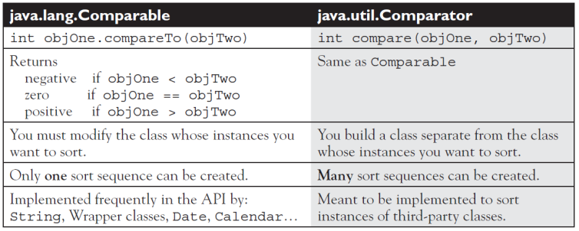
Comparable and Comparator

Slide 20
Data Structures
Data Structures – four basic:
Array,
Linked list,
Hashtable,
Tree.

Slide 21
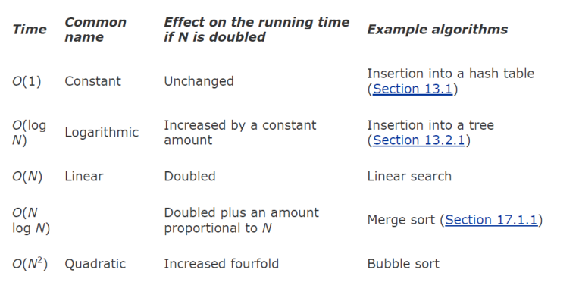
Efficiency and the O-Notation

Slide 22
Efficiency and the O-Notation
int CompareSmallestNumber (int array[ ]) {
int x, curMin;
curMin = array[0];
for (x = 1; x < 10; x++) {
if (array[x] < curMin) {
curMin = array[x];
}
}
return curMin;
}

Slide 23
Efficiency and the O-Notation
int CompareToAllNumbers (int array[ ]) {
bool is Min;
int x, y;
for (int x = 0; x < 10; x++) {
isMin = true;
for (int y = 0; y < 10; y++) {
if(array[x] > array[y]) {
isMin = false;
}
}
if(isMin) {
break;
}
}
}

Slide 24

Contracts
Contract – an obligation of both, interface and developer.

Slide 25
Collections and Thread Safety

Slide 26
JDK 1.0: Synchronization and the Legacy Collections
Collection classes from JDK 1.0, such as Vector and Hashtable, were fully synchronized
It means that all the methods that were accessing their instance data were synchronized
This policy imposed high price on all clients of these classes
Forced threads to queue up to enter the critical section
Slowed down the overall execution time of the program
Lock administration overhead
These classes are now considered legacy, which should be avoided

Slide 27
JDK 1.2: Synchronized Collections
The behavior was fixed when the Collections framework was introduced in JDK 1.2
The implementations of the interfaces List, Set and Map were optimized for single-threaded execution
No concurrency at all
It was the client responsibility to handle the synchronization issue
But what if someone wanted to retain the old concurrency policy?
One could call one of the factory methods in the Collections class
They create a wrapper implementing the interface and delegate method calls to the supplied collection, but the calls are synchronized on the wrapper object
Notes:
Foreach i remove - ConcurrentModificationException

Slide 28
JDK 1.2: Fail-Fast Iterators
Changes in concurrency policy required a change in the behavior of Iterator class
Iterators now check for structural modifications when accessing the backing collection
Such as adding or removing an element
If such a modification is found, they fail fast
A ConcurrentModificationException is being thrown immediately
This is because there is no reason in iterating over a modified collection with unpredictable results
Notes:
Foreach i remove - ConcurrentModificationException

Slide 29
Java 5 and Beyond: Concurrent Collections
Java 5 introduced a number of concurrency utilities:
Atomic variables
Lock
Compare-and-swap operations
Concurrent collections generally provide much better performance than synchronized collections
No need to serialize access
Less overhead when managing locks
There are several mechanism through which concurrent collections manage thread safety..

Slide 30
Copy-on-write
A class using that mechanism stores its value in an internal array, which is effectively immutable
Any change to the value of the collection results in a new array being created
The data are copied during each store operation, which obviously takes time
However, the read operations do not require any synchronization, so they are fast
It performs really well if reads greatly predominate over writes
Used by CopyOnWriteArrayList and CopyOnWriteArraySet

Slide 31
Compare-and-swap (CAS)
Considered a fundamental improvement on traditional synchronization
Instead of holding an exclusive access to a variable, CAS-based algorithms make a local copy and use it for calculations
Once they are finished, they compare the local copy with the variable in one atomic operation and then act as required
If the values are the same, they update the variable with the value of the calculated copy
If they are not the same, then some other thread must have modified the variable
Used by ConcurrentLinkedQueue and ConcurrentSkipListMap

Slide 32
java.util.concurrent.locks.Lock based
The newly introduced Lock class provided a more flexible way of synchronizing threads
Introduced the unlock method that allowed threads to drop the lock when they see fit
Some of the collection classes uses it to divide the collection into parts that can be separately locked
Improved concurrency
For instance, LinkedBlockingQueue uses different locks for head and tail ends of the queue, so that elements can be added or removed simultaneously
Used by BlockingQueue, LinkedBlockingQueue and ConcurrentHashMap

Slide 33
Iterator policies
The mechanisms introduced before requires refining the fail-fast iterator policy
Fail fast considers concurrent modification an error that needs to be eliminated
Not suitable for concurrent usage!
Copy on write uses snapshot iterators
Operate on immutable array
Do not throw ConcurrentModificationException
CAS and Lock based collections use weakly consistent iterators
Changes made to the collection after creating the iterator are not necessarily reflected
Also do not throw ConcurrentModificationException

Slide 34
The Collection Interface

Slide 35
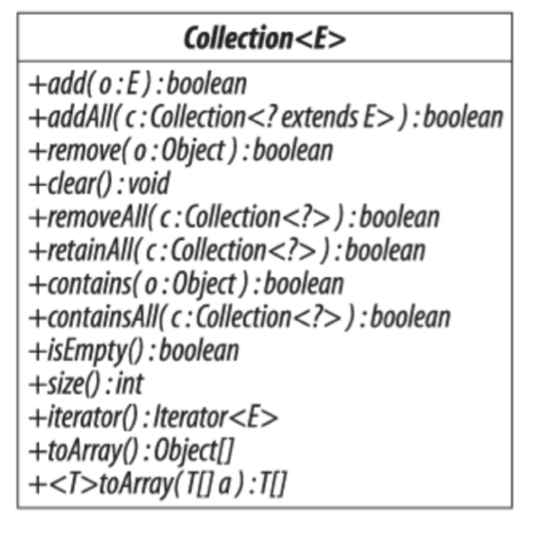
The Collection Interface
This is the super-interface that defines the core functionality of any collection other than a map
No direct implementations

Slide 36
Sets

Slide 37
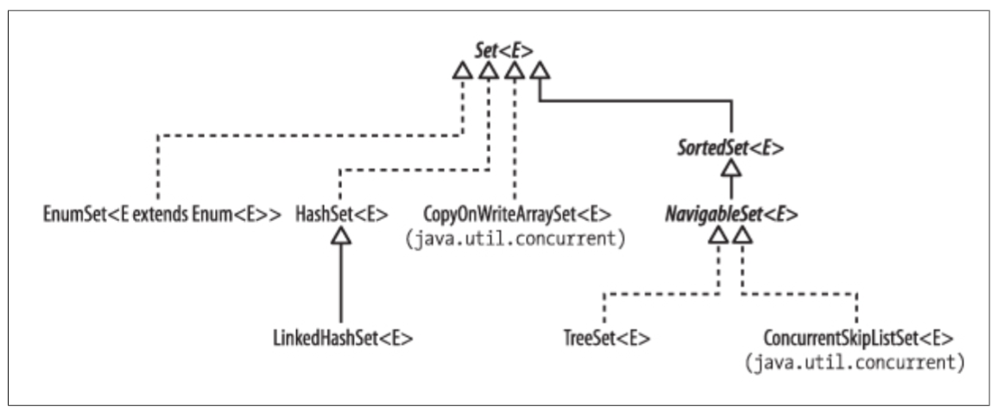
The Set Interface
Collection of items that does not allow duplicates
Adding an item that is already present in the set has no effect
There are six implementations of Set interface in the framework

Slide 38
HashSet
Most commonly used implementation of Set (isn’t it? ☺)
Delegates all of its operations to a private instance of HashMap
We’ll talk about HashMap later on
Implemented by a hash table
An array in which elements are stored at a position derived from their contents
Element’s position in a hash table is calculated by a hash function (remember hashCode() ?)
Has functions should give, as far as possible, an even spread of results
Unsynchronized and not thread-safe
Iterators are fail-fast

Slide 39
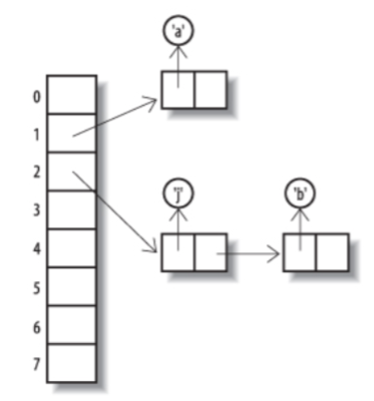
Hash table overflow
What happens if the backing hash table is too small to hold the values?
Or if our hash function is poorly implemented?
Collisions!
Linked list to the rescue
We can store all the colliding elements in a bucket
However, this increases the insertion cost
Rehashing
Copying data to a new, larger table when the load reaches a specified threshold (load factor)

Slide 40
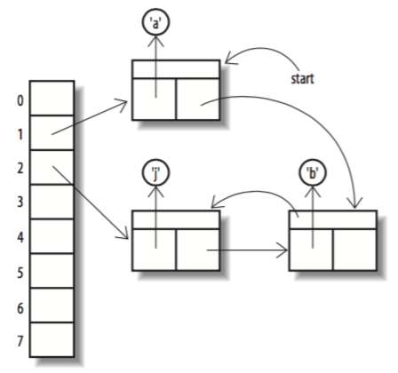
LinkedHashSet
Inherits from HashSet, refining its contract in a single aspect
Iterator of LinkedHashSet return its elements in the order of which they were added
It does so by maintaining a linked list of set elements

Slide 41
CopyOnWriteArraySet
Implemented as a thin wrapper around an instance of CopyOnWriteArrayList
Which is backed by an immutable array
Any change to the contents of the set results in the new array being created
Hence, both add and contains have complexity O(n) (linear search)
However, iteration cost is just O(1) per element (better than HashSet)
Provides thread-safety without adding to the cost of read operations
A great advantage over synchronized collections

Slide 42
EnumSet
Exists to take advantage of the efficient implementations when the number of elements is fixed
A unique index can be assigned to each of them
Enumerated types are a perfect candidate
Add, remove and contains have constant time performance
Implemented as simply bit manipulations
Not thread-safe, but the iterators are not fail-fast
The contract guarantees them to be weakly consistent

Slide 43
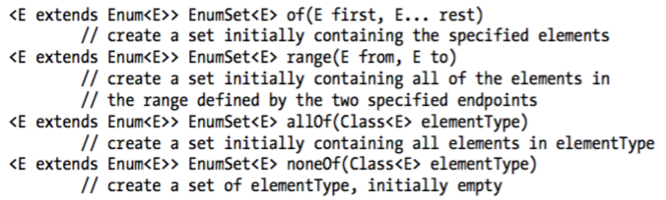
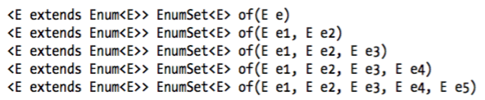
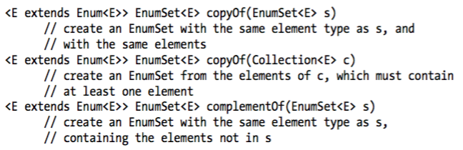
EnumSet – factory methods
Empty, specified elements only or all elements of the enum:
Optimized methods for creating sets of one, two, three, four or five elements:
Creation of an EnumSet from an existing collection:

Slide 44
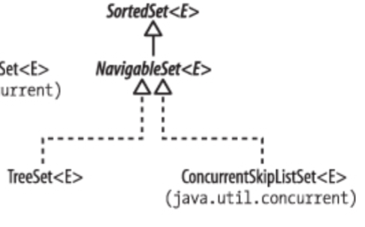
SortedSet and NavigableSet
Set has one subinterface, SortedSet
It adds to the Set contract a guarantee that its iterator will traverse the set in ascending element order
In Java 6, SortedSet was extended by another interface, NavigableSet, which adss methods to find the closest matches to a target element
The only implementation of SortedSet before Java 6 was TreeSet, but it was later retrofitted to also implement NavigableSet

Slide 45
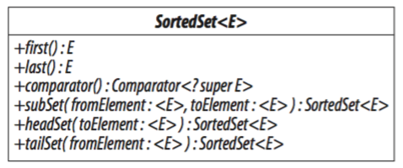
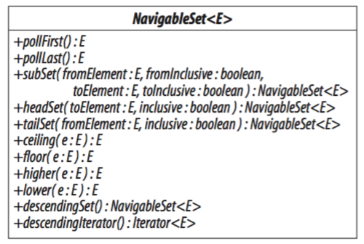
SortedSet and NavigableSet

Slide 46
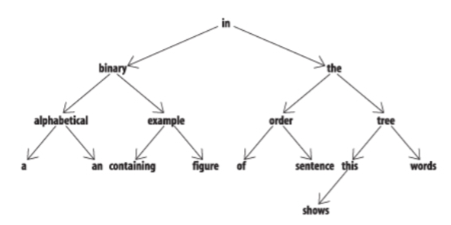
TreeSet
Based on tree data structure
Suitable for applications which require:
fast insertion and retrieval of single elements
Holding the elements in sorted order
Unsynchronized and not thread-safe
Notes:
For example, suppose you want to match all the words from a set against a given prefix, a common requirement in visual applications where a drop-down should ideally show all the possible elements that match against the prefix that the user has typed.
A hash table can’t return its elements in sorted order and a list can’t retrieve its elements quickly by their content, but a tree can do both.

Slide 47
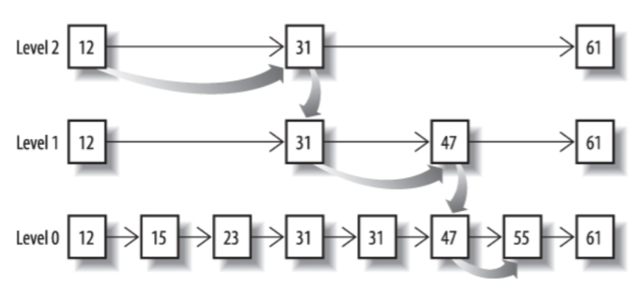
ConcurrentSkipListSet
Introduced in Java 6 as the first concurrent Set implementation
Backed by a skip list
A modern alternative to the binary trees
Skip list for a set is a series of linked lists, each composed of cells containing two fields
A value of the cell
A reference to the next cell
Iterators are weakly-consistent
Notes:
Figure 13-9 shows a skip list consisting of three linked lists, labelled levels 0, 1 and 2. The first linked list of the collection (level 0 in the figure) contains the elements of the set, sorted according to their natural order or by the comparator of the set. Each list above level 0 contains a subset of the list below, chosen randomly according to a fixed probability. For this example, let’s suppose that the probability is 0.5; on average, each list will contain half the elements of the list below it. Navigating between links takes a fixed time, so the quickest way to find an element is to start at the beginning (the left-hand end) of the top list and to go as far as possible on each list before dropping to the one below it.

Slide 48
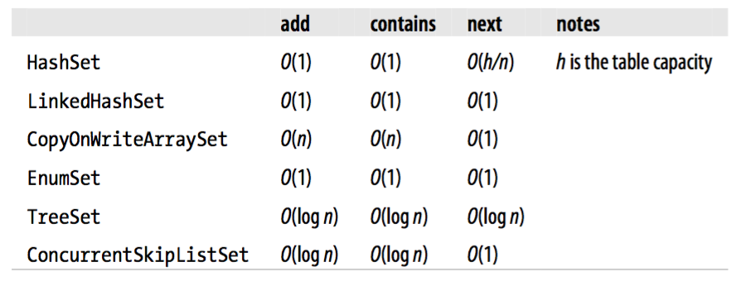
Comparing Set Implementations
Performance is one of the factors to take into account when choosing an implementation
Some of the implementations are specialized for specific situations:
EnumSet for representing sets of enum
CopyOnWriteArraySet should only be used if reads greatly outnumber writes, and the set size is relatively small
Think if you need thread-safety

Slide 49
Queues

Slide 50
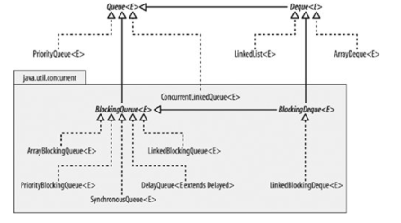
The Queue Interface

Slide 51
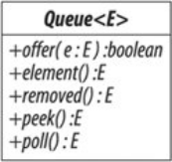
The Queue Interface

Slide 52
PriorityQueue
Non-blocking
Not thread-safe

Slide 53
PriorityQueue
final int INITIAL_CAPACITY = 10;
Comparator<PriorityTask> priorityComp = new Comparator<PriorityTask>(){
public int compare(PriorityTask o1, PriorityTask o2) {
return o1.getPriority().compareTo(o2.getPriority());
}
};
Queue<PriorityTask> priorityQueue = new PriorityQueue<>(INITIAL_CAPACITY, priorityComp);
priorityQueue.add(new PriorityTask(mikePhone, Priority.MEDIUM));
priorityQueue.add(new PriorityTask(paulPhone, Priority.HIGH));
...
PriorityTask nextTask = priorityQueue.poll();

Slide 54
PriorityQueue
Dodawanie:
Usuwanie:

Slide 55
ConcurrentLinkedQueue
Non-blocking
Unbounded
Thread-safe
FIFO

Slide 56
BlockingQueue - Interface

Slide 57
LinkedBlockingQueue
Thread-safe
FIFO
Linked node structure
Unbounded
Blocking

Slide 58
ArrayBlockingQueue

Slide 59
PriorityBlockingQueue
Thread-safe
Blocking

Slide 60
DelayQueue
interface Delayed extends Comparable<Delayed> {
long getDelay(TimeUnit unit);
}
SynchronousQueue
„Empty queue”

Slide 61
Deque
Java 6.
Double-ended queue
FIFO / LIFO

Slide 62
Deque

Slide 63
Deque implementations
ArrayDeque
LinkedList

Slide 64
BlockingDeque

Slide 65
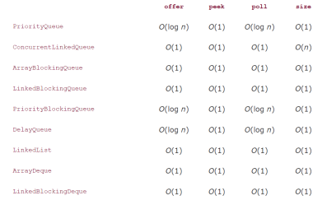
Comparing

Slide 66
Lists

Slide 67
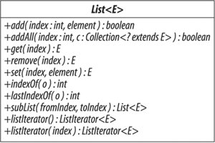
The List Interface

Slide 68
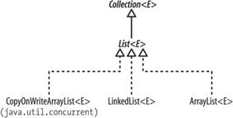
The List Implementations

Slide 69
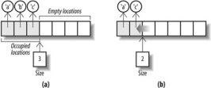
ArrayList

Slide 70
LinkedList – structure similiar to Deque
CopyOnWriteArrayList

Slide 71
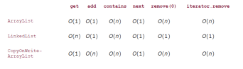
Comparing List Implementations

Slide 72
Maps

Slide 73
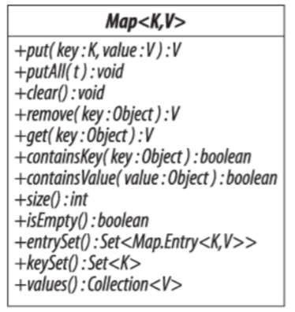
The Map Interface
Does not inherit from Collection interface!
Defines operations supported by a set of key-value associations, in which keys are unique

Slide 74
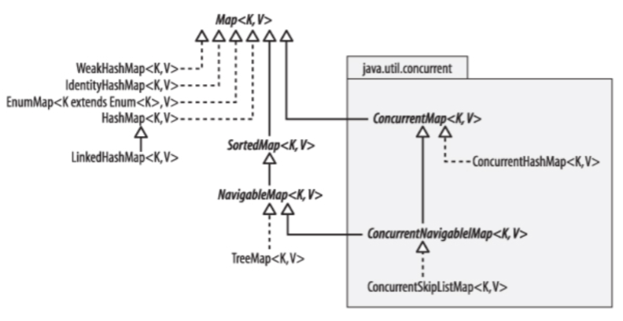
The Map Interface
There are 8 Map implementations in total provided by Collections Framework

Slide 75
HashMap
Most often used implementation
Backed by hash table
Constant-time performance for put and get when no collisions
Uses rehashing to control the load and thereby minimize the number of collisions
Iteration over a collection or value sis proportional to the capacity of the map plus the number of mappings it contains
Unsynchronized and not thread-safe

Slide 76
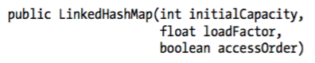
LinkedHashMap
Extends HashMap and refines its contract by guaranteeing the order in which iterators return its elements
Unlike LinkedHashSet, it offers a choice of iteration orders:
Either in the order in which they were inserted in the map
Or in the order in which they were accessed (from least-recently to most-recently accessed)
We can control it by the accessOrder parameter of the constructor:

Slide 77
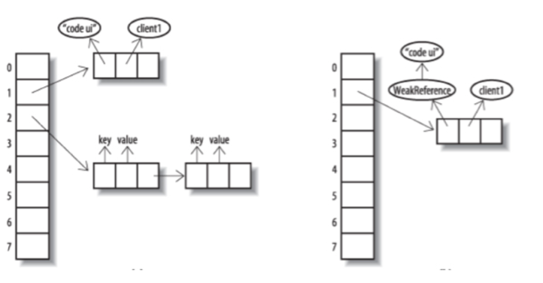
WeakHashMap
Regular HashMap keeps ordinary (“strong”) references to the objects it contains
Prevents the objects from being garbage collected
Most often this is exactly what we want
WeakHashMap holds ”weak” reference instead
If we don’t hold the reference to a key, the entry may be garbage collected
May come in handy if the map is large and the memory is short
HashMap
WeakHashMap

Slide 78
IdentityHashMap
Yet another HashMap variant
Instead of using equals to compare the keys, it uses object identity (==)
It violates the Map interface contract!
The contract states that equality should be used for key comparison
It could have been avoided by introducing another interface (IdentityMap?), but the designers decided otherwise, to prevent increasing the framework complexity
Commonly used in operations such as serialization
It includes traversing a cyclic graph
For cyclic graph, it is often more feasible to use object identity rather than equality

Slide 79
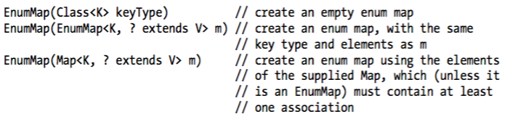
EnumMap
Map implementation optimized for mapping from an enumerated type
Straightforward and very efficient
Three public constructors
EnumMap needs a reified key type, so that it could check the validity of new entries at run time
Not thread safe
Iterators are weakly consistent

Slide 80
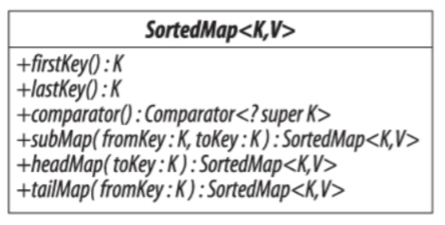
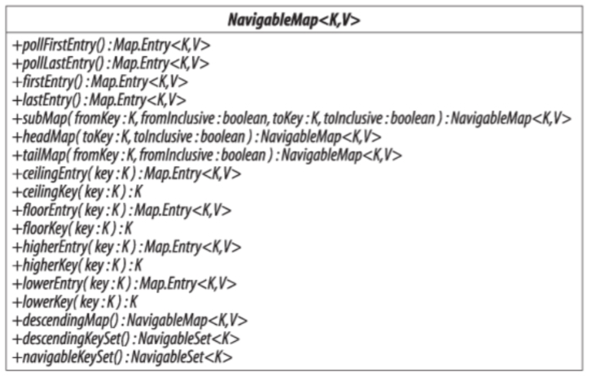
SortedMap and NavigableMap
Much like SortedSet, SortedMap adds an iterator traversal policy to Map interface
Iterators will traverse the map in the ascending key order
In Java 6, NavigableMap was added
It made SortedMap interface obsolete

Slide 81
TreeMap
Implements NavigableMap
Mechanism and performance is exactly the same as for the TreeSet
In fact, TreeSet uses a private instance of TreeMap internally
Not thread safe, iterators are fail-fast

Slide 82
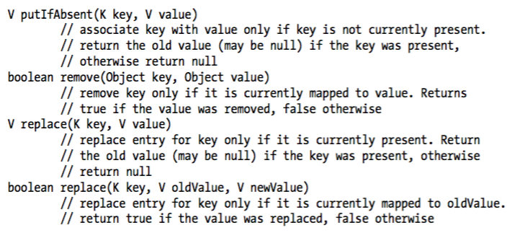
ConcurrentMap
ConcurrentMap is another subinterface of Map, which adds to a number of atomic operations to the standard contract
Some applications (like high-end servers) require high-throughput thread-safe map implementations
Collections.synchronizedMap cannot be used because of their full synchronization policy

Slide 83
ConcurrentHashMap
Provides high throughput and thread-safety
Optimized for reading
Does not block even while the table is being updated
Iterators are weakly consistent
The contract states that the results of retrievals will reflect the latest update operations completed before the start of the retrieval

Slide 84
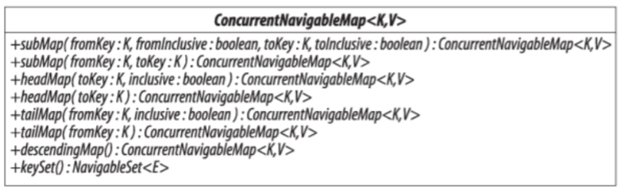
ConcurrentNavigableMap and ConcurrentSkipListMap
ConcurrentNavigableMap inherits from both ConcurrentMap and NavigableMap
Contains just the methods if these two interfaces
Makes few changes to them to make the return types more precise
ConcurrentSkipListMap is the only implementation
Since ConcurrentSkipListSet is internally implemented by ConcurrentSkipListMap, their performance characteristics and mechanism of work remain the same

Slide 85
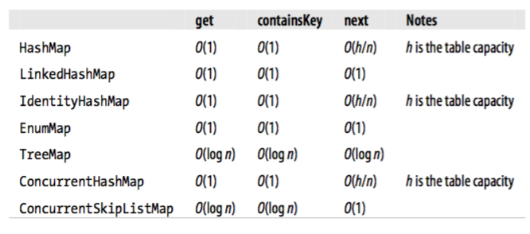
Comparing Map Implementations

Slide 86
The Collections class

Slide 87
Collections class
Provides a number static methods that operate on or return collections
Three main categories:
Generic algorithms
Collection factories
Wrapper factories
Also provides other utility methods
Homework ☺

Slide 88
Summing up..

Slide 89
Summary
Learn the framework, its data types and contracts
Think what kind of collection (set, queue, list, map) would suite your needs best
Consider using navigable types (NavigableSet, NavigableMap etc)
Remember about the contracts!
Learn how different implementations differ from one another
As you saw, there’s so more than ArrayList, HashSet and HashMap
Pick the implementation that meets your requirements best
Think about concurrency
Do not reinvent the wheel!
Use EnumSet / EnumMap for enumerated types
Use concurrent collections instead of synchronized ones (and refactor if you already have them in your codebase!)
And, most importantly..

Slide 90
Summary
Read the book – it’s good for you ☺
And you’ll become much better programmer too!

